Slide 1
Clipping
Course Code: CSC 3224
Course Title: Computer Graphics
Dept. of Computer Science
Faculty of Science and Technology
Lecturer No: | 14 | Week No: | 11 | Semester:
Lecturer:

Slide 2
Lecture Outline
Clipping
Pont Clipping
Line Clipping (Derivation)
Line Clipping (Problem Solving)

Slide 3
Clipping
Clipping, in the context of computer graphics, is a method to selectively enable or disable rendering operations within a defined region of interest.
A rendering algorithm only draws pixels in the intersection between the clip region and the scene model. Lines and surfaces outside the view volume are removed.

Slide 4
Clipping Type
Types of clipping
Point clipping
Line clipping
Polygon clipping

Slide 5
Point Clipping
For a point (x,y) to be inside the clip rectangle:

Slide 6
Point Clipping
For a point (x,y) to be inside the clip rectangle:

Slide 7
Line Clipping
Cases for clipping lines

Slide 8
Line Clipping
Cases for clipping lines

Slide 9
Line Clipping
Cases for clipping lines

Slide 10
Line Clipping
Cases for clipping lines

Slide 11
Line Clipping
Cases for clipping lines

Slide 12
Line Clipping
Cases for clipping lines

Slide 13
The Cohen-Sutherland Line-Clipping
The Cohen-Sutherland Line-Clipping Algorithm performs initial tests on a line to determine whether intersection calculations can be avoided.

Slide 14
Line Clipping (Example)

Slide 15
Line Clipping (Example)

Slide 16
Line Clipping (Example)

Slide 17
COHEN SUTHERLAND LINE CLIPPING (Derivation)

Slide 18
Line Clipping (Derivation)

Slide 19
Line Clipping (Derivation)

Slide 20
Line Clipping (Derivation)

Slide 21
Line Clipping (Derivation)

Slide 22
Line Clipping (Derivation)

Slide 23
Line Clipping (Derivation)

Slide 24
Line Clipping (Derivation)

Slide 25
Line Clipping (Derivation)

Slide 26
Line Clipping (Derivation)

Slide 27
Line Clipping (Derivation)

Slide 28
Line Clipping (Derivation)

Slide 29
Line Clipping (Derivation)

Slide 30
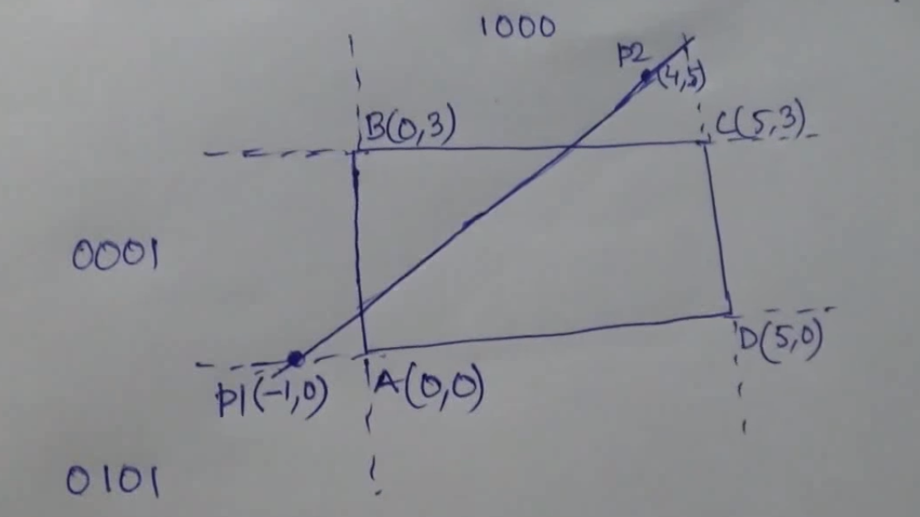
Problem Solving (Line Clipping)

Slide 31
Problem Solving (Line Clipping)

Slide 32
Problem Solving (Line Clipping)

Slide 33
Find Slope, m

Slide 34
Problem Solving (Line Clipping)

Slide 35
Find Y1ʹ

Slide 36
Problem Solving (Line Clipping)

Slide 37
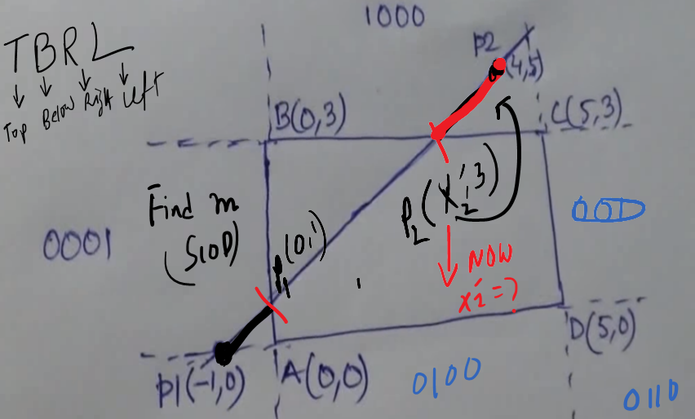
Find X2ʹ

Slide 38
Find X2ʹ

Slide 39
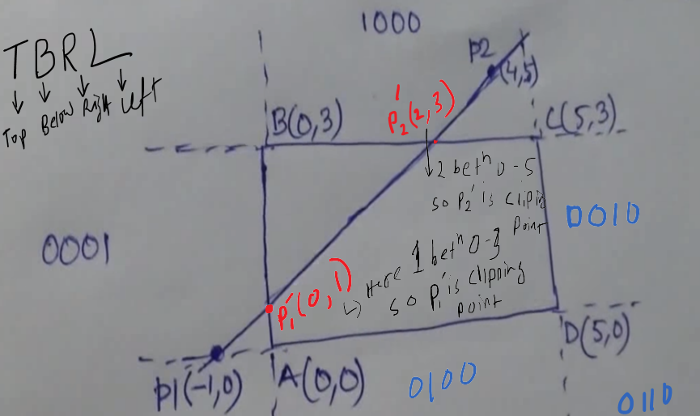
Finally

Slide 40
Books
Foley, van Dam, Feiner, Hughes, Computer Graphics: principles and practice, Addison Wesley, Second Edition.
Schaum's Outline of Theory & Problems of Computer Graphics.
Peter Shirley Steve Marschner , “Fundamental of computer graphics”, Third Edition.

Slide 41
References
Chapter 3: Foley, van Dam, Feiner, Hughes, Computer Graphics: principles and practice,
Addison Wesley, Second Edition.
https://en.wikipedia.org/wiki/Clipping_(computer_graphics)
https://www.onlinestudy.xyz/2019/06/clipping-in-computer-graphics.html

